Slide 1
R Programming
Console Input & Evaluation

Slide 2
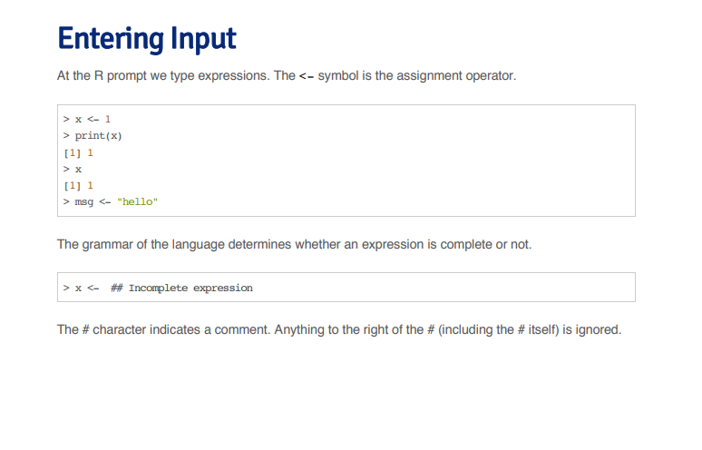

Slide 3
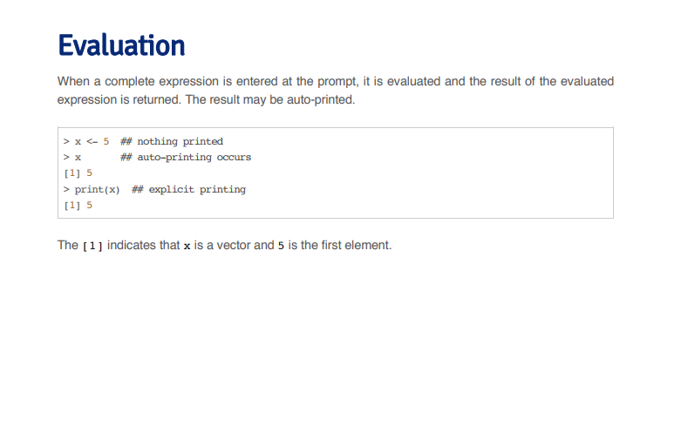

Slide 4
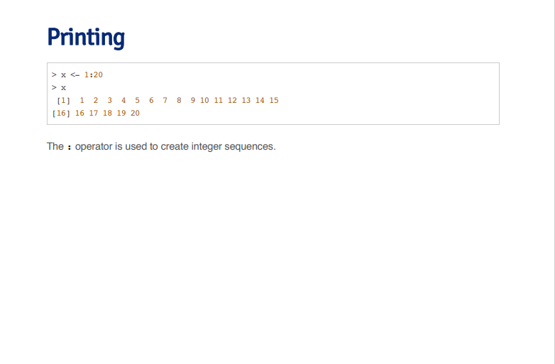

Slide 5
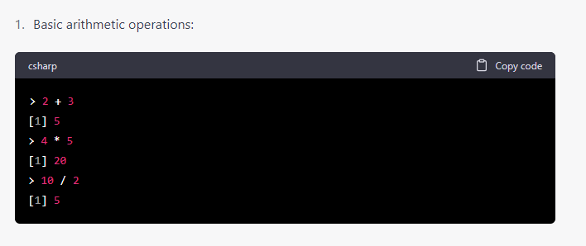
Please try the following examples in your console:

Slide 6
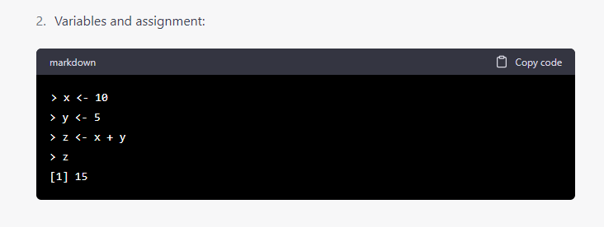
Please try the following examples in your console:

